Slide 1
CHAPTER 4 Optimal Predictive Control 10 Tracking and disturbance rejection
Anthony Rossiter

Slide 2
Introduction
The previous videos in this chapter have presented OMPC/SOMPC control law for the nominal case, assuming no constraints and assuming the states and disturbance are known.
In practice both the states and the disturbance must be estimated.
This video introduces a simple observer and independent model approach and uses MATLAB to demonstrate the potential impact this has on performance.

Slide 3
Independent modelling approach
The process model is assumed to be:
A output disturbance estimate can be determined from:
A simple independent model takes the form:

Slide 4
Independent model structure
A model is simulated in parallel with the real process to estimated ‘d’.
Disturbance and model parameters are used to estimate the steady-state. State is taken from the independent model.

Slide 5
Independent model structure
A model is simulated in parallel with the real process to estimate ‘d’.
Control law based on independent model state, which is known.

Slide 6
Assume no modelling errors however incLude a disturbance which must be estimated

Slide 7
video4_10_example 1.m
OMPC simulation, SISO system, introduce a target change and a disturbance change.
Assume independent model and process are identical, apart from unknown disturbance. [SYSTEM IS NON-MINIMUM PHASE!]
OBSERVATIONS
Model and process output the same for target changes while disturbance is zero.
Once a disturbance occurs, the process output and independent model output differ.
Nevertheless, offset free tracking is obtained.

Slide 8
video4_10_example 2.m
SOMPC simulation, MIMO system, introduce a target change and a disturbance change.
Assume independent model and process are identical, apart from unknown disturbance.
OBSERVATIONS
Model and process output the same for target changes while disturbance is zero.
Once a disturbance occurs, the process output and independent model output differ.
Nevertheless, offset free tracking is obtained.

Slide 9
AS THERE ARE no modelling errors, GUARANTEES OF CONVERGENCE AND SO ON CARRY OVER AUTOMATICALLY, REGARdLESS OF THE FACT THAT THE disturbance must be estimated.

Slide 10
Assume SOME modelling errors ALSO incLude a disturbance which must be estimated

Slide 11
video4_10_example3.m
OMPC simulation, SISO system, introduce a target change, a disturbance change and parameter uncertainty.
OBSERVATIONS
Model and process output differ, even for target changes while disturbance is zero.
Nevertheless, offset free tracking is obtained both for non-zero targets and disturbance rejection.
Control law may not be robust as evidenced by relatively poor behaviour.

Slide 12
video4_10_example4.m
SOMPC simulation, SISO system, introduce a target change, a disturbance change and parameter uncertainty.
OBSERVATIONS
Model and process output differ, even for target changes while disturbance is zero.
Nevertheless, offset free tracking is obtained both for non-zero targets and disturbance rejection.
Control law may not be robust as evidenced by relative poor behaviour.

Slide 13
Conclusions
Extensions for OMPC/SOMPC for tracking and disturbance rejection are straightforward using the concepts from chapter 1. Ensure the performance index and the predictions are unbiased.
This video uses an independent model form to ensure unbiased prediction and for ‘state estimation’.
For this case, SOMPC/OMPC will deal with some level of parameter uncertainty and the fact that disturbances need to be estimated.
However, this is not to say that we have any particular insight on the robustness of the algorithms to parameter uncertainty and whether alternatives would be much less sensitive.

Slide 14



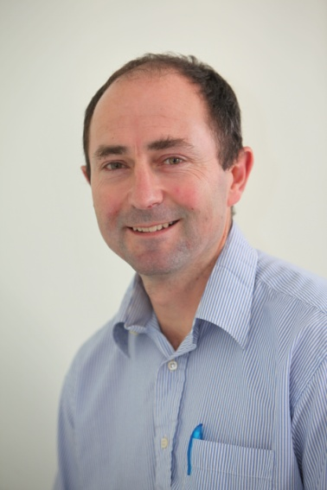
Anthony Rossiter
Department of Automatic Control and Systems Engineering
University of Sheffield
www.shef.ac.uk/acse
© 2014 University of Sheffield
This work is licensed under the Creative Commons Attribution 2.0 UK: England & Wales Licence. To view a copy of this licence, visit http://creativecommons.org/licenses/by/2.0/uk/ or send a letter to: Creative Commons, 171 Second Street, Suite 300, San Francisco, California 94105, USA.
It should be noted that some of the materials contained within this resource are subject to third party rights and any copyright notices must remain with these materials in the event of reuse or repurposing.
If there are third party images within the resource please do not remove or alter any of the copyright notices or website details shown below the image.
(Please list details of the third party rights contained within this work.
If you include your institutions logo on the cover please include reference to the fact that it is a trade mark and all copyright in that image is reserved.)

